Slide 1


Green Tech
Daemon Team, Shrinik Club, GLBITM

Slide 2
TABLE OF CONTENTS
01
02
03
04
OVERVIEW OF PROBLEM
SOLUTION/APPROACH
Here we will discuss problem caused by food wastage
Here we will discuss about the solution for this food wastage problem
ANALYSIS
CONCLUSION
We will discuss about information flow and will give a prototype demonstration
Discussing about the feasibility of our solution

Slide 3
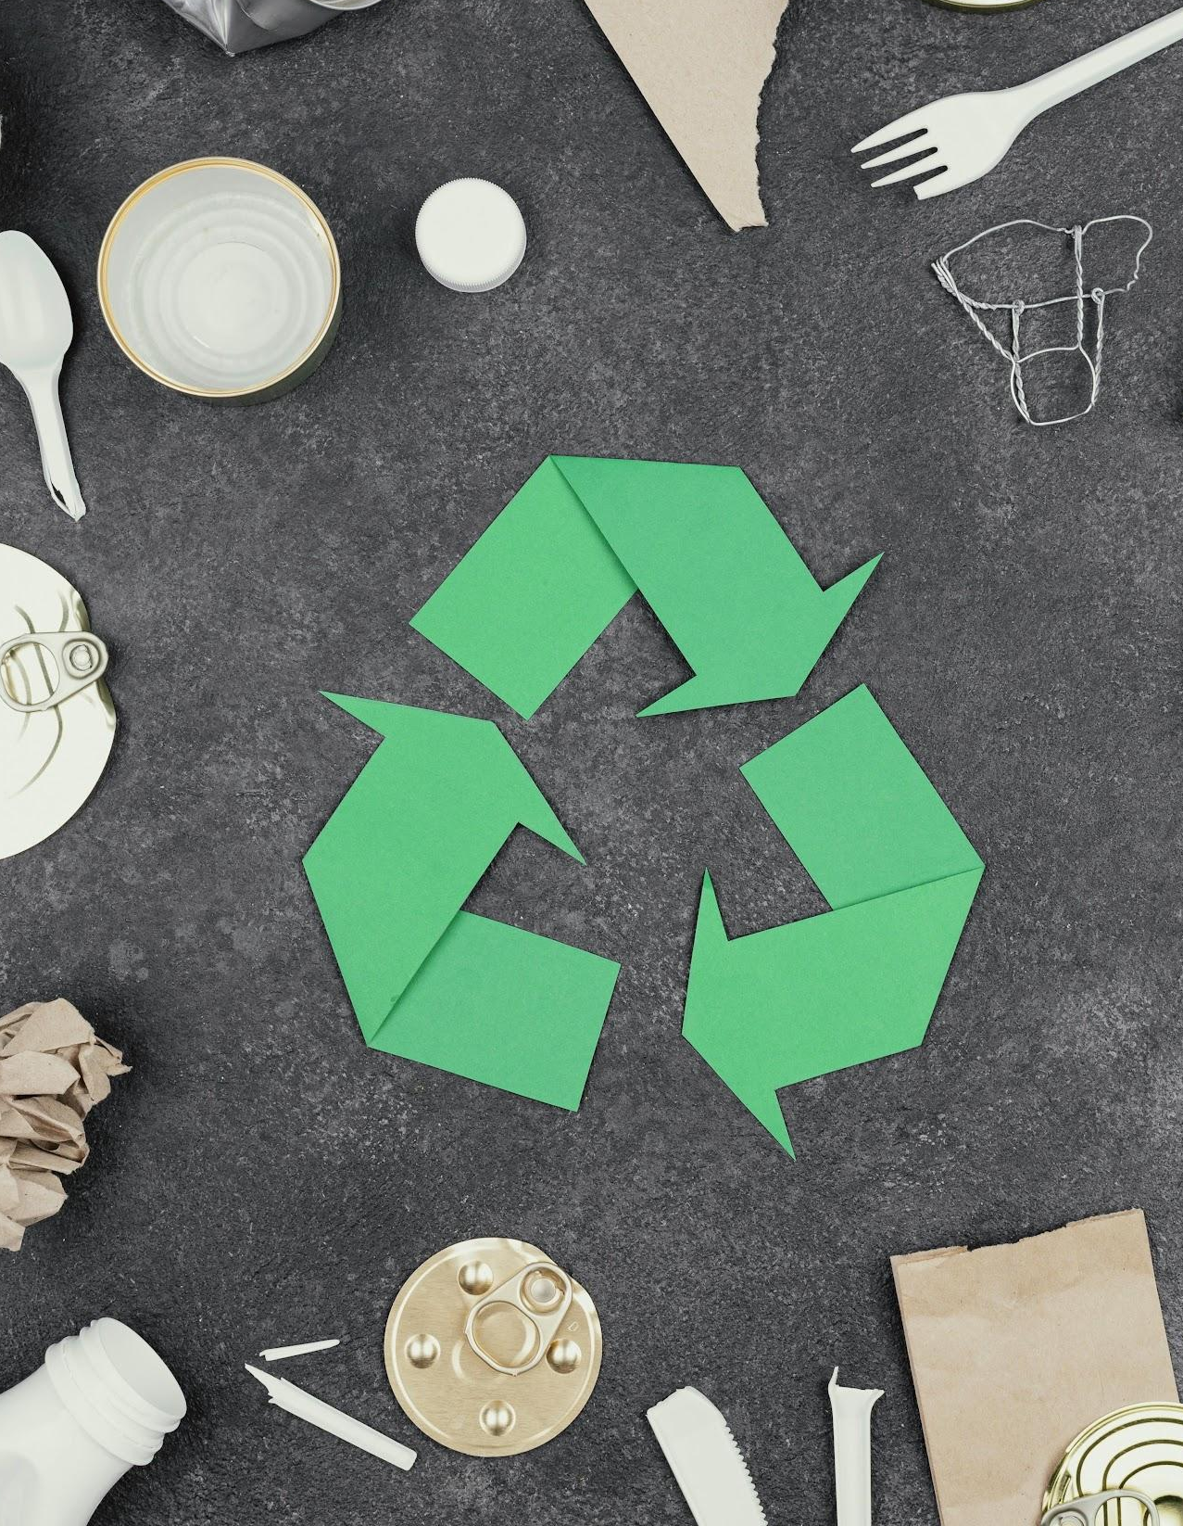
PROBLEM
In Southeast Asia, food waste is discharged daily from factories, restaurants, supermarkets, etc. This waste has potential to be reused as an organic resource providing it can be transformed with the correct technology. It is found that there is discharge of food waste daily from various types of places i.e. restaurants, factories, supermarkets etc.
So, Collection of the food waste from such areas and categorizing them to what they can be used into is a major task for this problem statement.

Slide 4
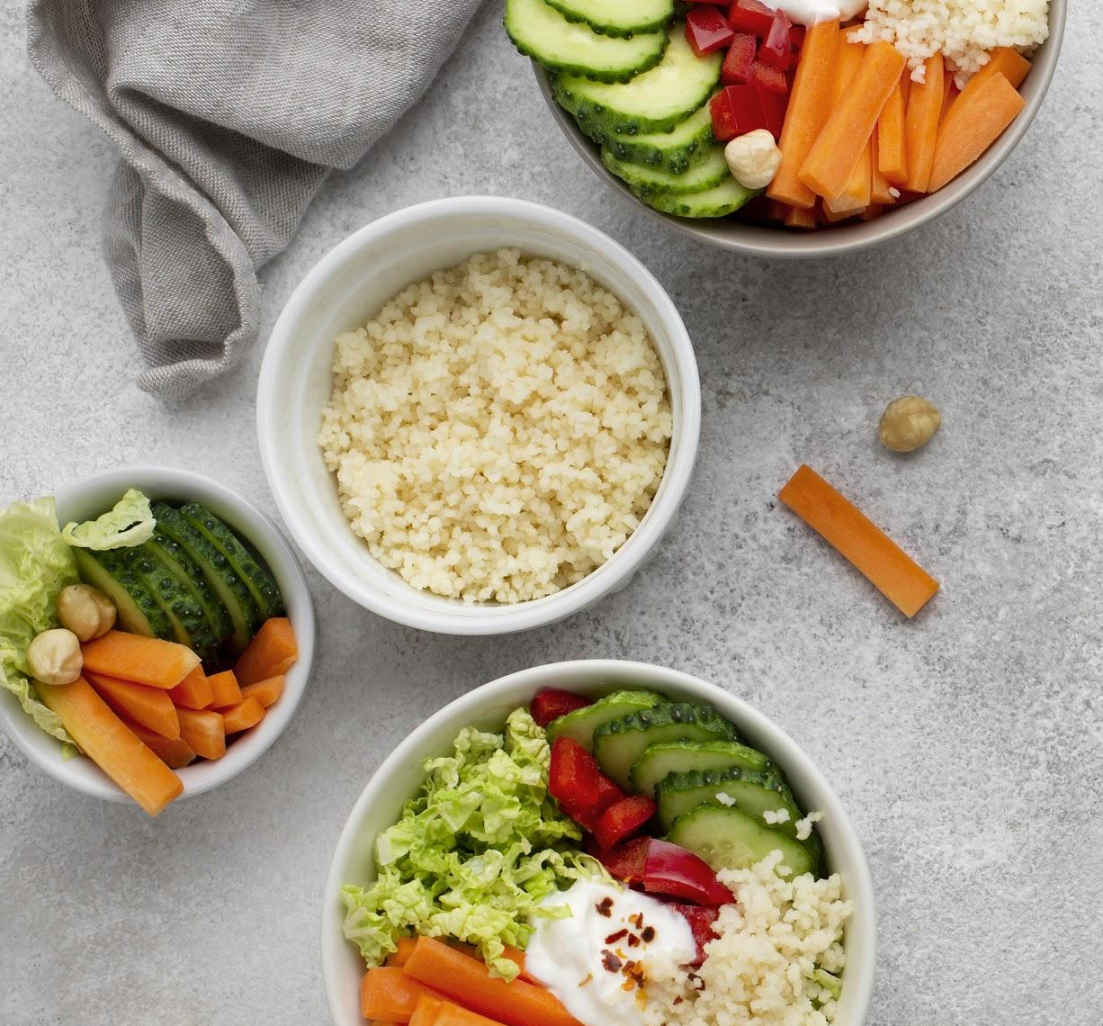
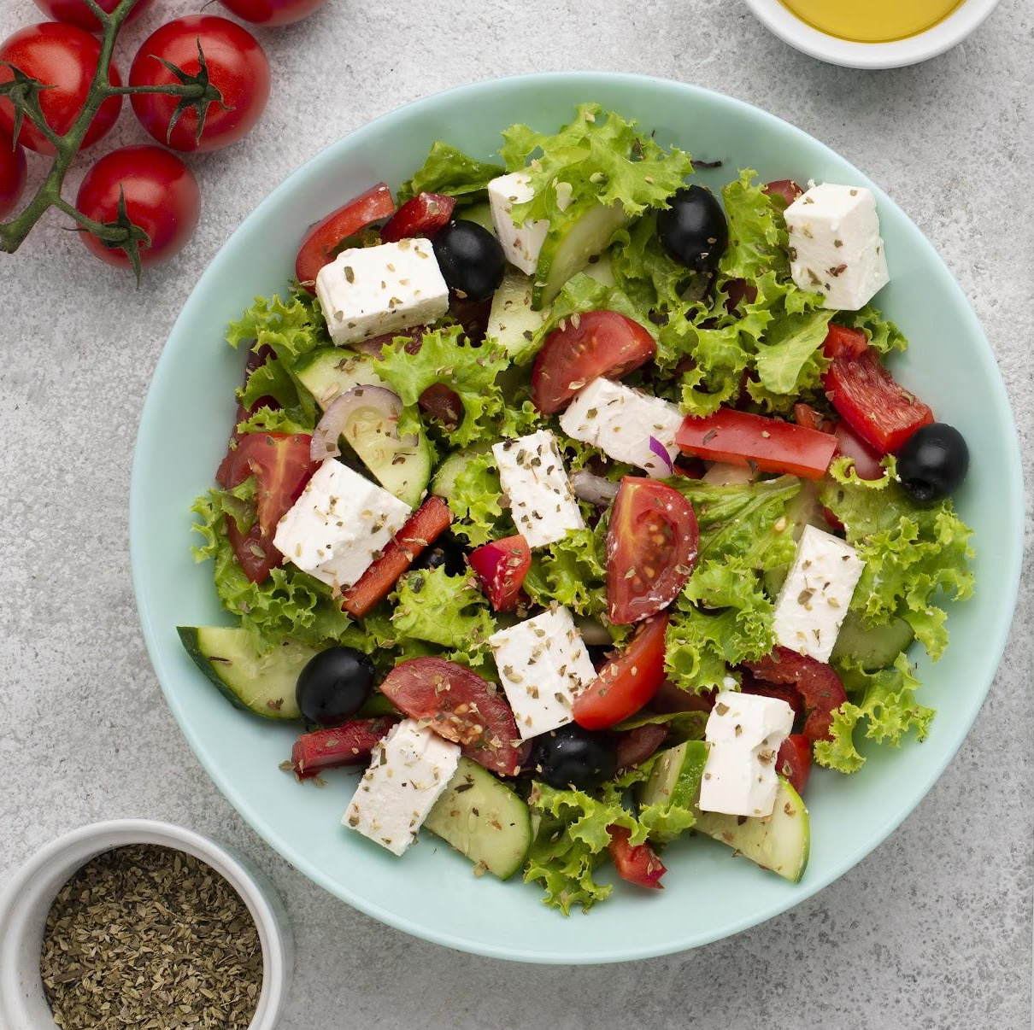
#1
SOLUTION/APPROACH

Slide 5
SOLUTION
As we know from our PG/hostel/any public event, there is a lot of food wastage around us. On one hand people don’t have enough food for survival and on the other,extra food is being thrown away.
For acting on this issue, we decided to come up with a solution which we think is quite feasible and practical.
Our approach for tackling this problem is to collect this extra food from these food outlets/people, and after proper packaging, this food is made available for those who need it at minimal prices.

Slide 6
SOLUTION
STEP 1
STEP 2
The food distributing party provides info like quality,quantity of food,storage conditions,etc.
A transport party will be forwarded to the distributer location to collect the food
STEP 3
STEP 4
Then the food is transferred to the one who is asking through the app
By the review of the waste food the distributer will gain some redeem points.

Slide 7
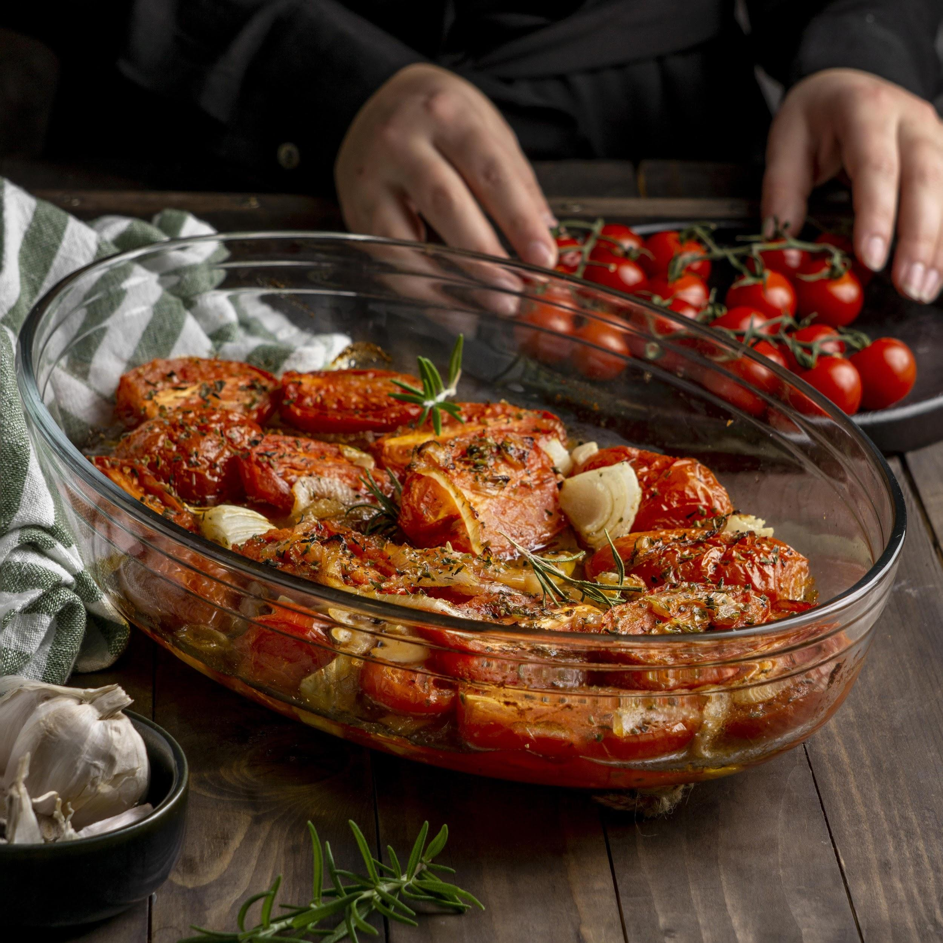
#2
ANALYSIS

Slide 8
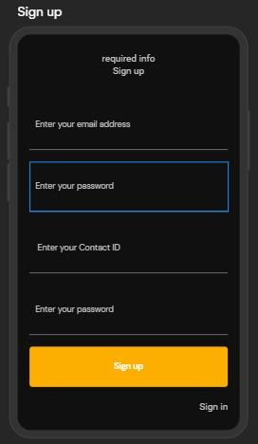
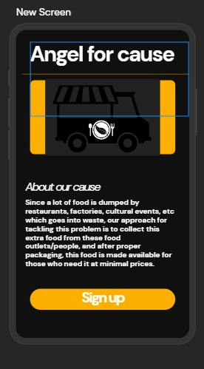
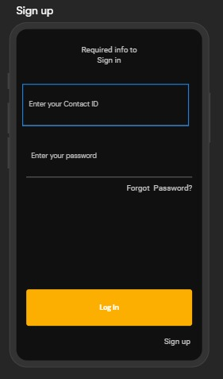
INFORMATION-FLOW DIAGRAM
If the user chooses to Signup he will be asked to fill some basic formalities of himself.
If the user chooses to login he will have to fill in the credentials.
The user will be asked for
To do login or sign-up.

Slide 9
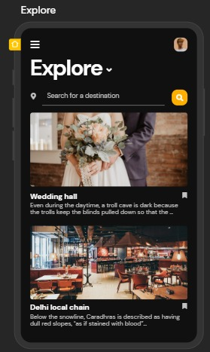
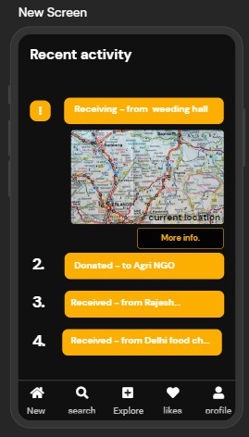
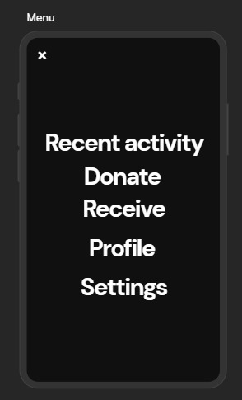
INFORMATION-FLOW DIAGRAM
The user will be redirected
to the Explore page where
he can see nearby Donars
and receivers.
This will be the option page
from where the user can
access multiple options.
From here the user can
see his previous donations
or the food he received

Slide 10
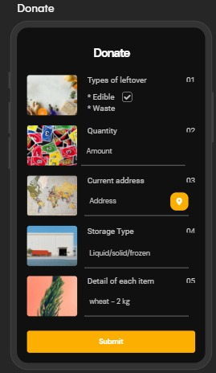
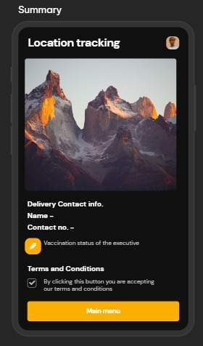
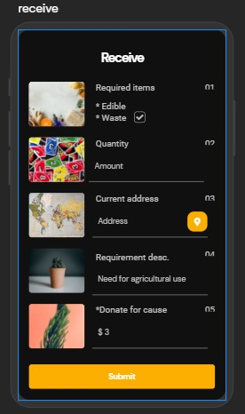
Donor screen
Information goes in backend for the delivery boy
After this whole process the user will be redirected to the explore page once again.
Receiver screen
Both the donor and receiver will see the tracking page to know the current status of food.

Slide 11
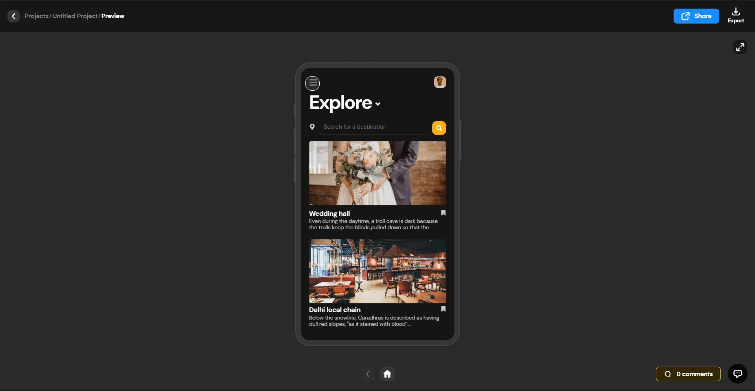
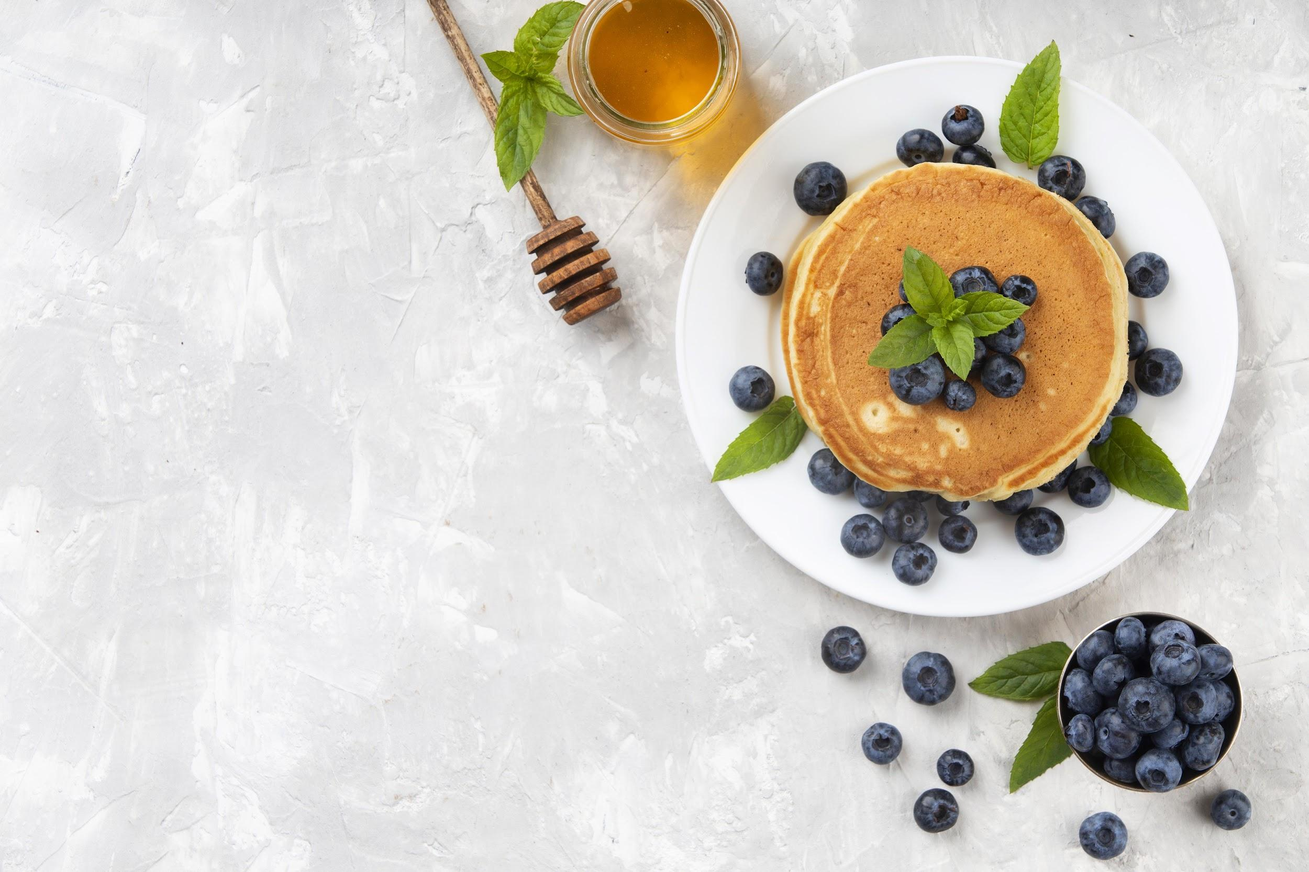
PROTOTYPE DEMO

Slide 12
CONCLUSION

